Slide 1


JavaScript

Slide 2

What is JS?
Based on ECMAScript (actual version ES6)
Interpreted programming language
The only accepted on client side
Many features
Improves interaction
Dynamic requests - Axios / Fetch
Animations
Canvas

Slide 3
JavaScript - Variables
Not typed
Not mandatory to be initialized
Local / global scope
var a, b , c;
var firstname;
var nothing = null;
firstname = "Doe";
a = 1;
b = 2;
c = a + b;

Slide 4
JavaScript - Variables
Primitive types:
Undefined: value not assigned
Null: “no value”. Object.
Number: any type of number
Boolean: true or false
String: any kind of string
var num = 1.16;
var firstname = "Doe";
var nothing = null;
var choose = false;
var idk;
typeof firstname // "string"
typeof num // "number"
typeof nothing // "null"
typeof choose // "boolean"
typeof idk // "undefined"

Slide 5
JavaScript - Variables : Var vs Let
Scoping Rules:
Var is scoped to the immediate Function.
Let is scoped to the immediate “ { } ”.
function foo() {
for(var i = 0; i < 5; i++)
console.log('it: ', i)
console.log('Final i: ', i)
}
function foo2() {
for(let i = 0; i < 5; i++)
console.log('it: ', i)
console.log('Final i: ', i)
}

Slide 6
JavaScript - Variables
Arrays
Objects
var bag = ['books', 'laptop', 2];
bag[0] = 'books';
var song = {
name:"Bohemian Rhapsody",
artist:"Queen",
album:"A Night at the Opera",
fullName: function(){ this.name + " - " + this.artist },
duration:5.55
};
alert(song.duration); // 5.55

Slide 7
JavaScript - Spread operator
var a = [0,1,2]
var b = [3,4,5]
var c = [ ...a, ...b ] // [ 0,1,2,3,4,5 ]
const member = {
name: 'ahsoka',
type: 'padawan'
}
const team = { ...member, drone: 'r2d2' }
const { drone } = team

Slide 8
JavaScript - Syntax
Operators | Conditional Statements | Loops
+ // addition
- // subtraction
* // multiplication
/ // division
% /* modulus
* (remainder)
*/
++ // increment
-- // decrement
if (...) {
...
} else if (...) {
...
} else {
...
}
=== // equal valor & type
== // equal valor
!== // not equal valor & type
!= // not equal valor
> // bigger than
>= // bigger or equal than
< // smaller than
<= // smaller or equal than
var i = 0;
while (i < 10) {
alert("Number " + i);
i++;
}
for (var i = 0;
i < bag.length;
i++) {
sum += bag[i];
}
&& // and
|| // or
! // not

Slide 9
JavaScript - Functions
Named functions
Anonymous functions
function whatTime() {
alert("it’s time to take a break");
return 1;
}
bagArray.forEach( function() {
alert(this);
});

Slide 10
JavaScript - Functions
Arrow function:
With only 1 statement and returning value:
var whatTime = () => {
return alert('time to take a break')
}
var whatTime = () => alert('time to take a break')

Slide 11
JavaScript - this
Special keyword that refers to current object/function
Very tricky sometimes
document.getElementById("btn").onclick(function (){
console.log(this.innerHTML);
});
var test = {
prop: 42,
func: function() {
return this.prop;
},
};
bagMap.forEach( function() {
alert(this.numItems);
});

Slide 12
JavaScript - Callbacks
Functions that execute AFTER something happens.
setTimeout(() => {
console.log('Ya han pasado 3 segundos!')
}, 3000);

Slide 13
JavaScript - Callbacks : Custom Callbacks
const getUser = (id, callback) => {
const user = {
name: 'yoda',
id
}
if (id === 20) {
callback(`The user with id: ${id} does not exist.`);
} else {
callback(null, user);
}
}
getUser(20, (err, user) => {
if(err) {
return console.log(err);
}
console.log('This is the user: ', user);
})

Slide 14

JavaScript - Callbacks : Problems
Multiple nested callbacks might muddle the code
Maintaining error control can be a nightmare

Slide 15
JavaScript - Promises
Similar to callbacks
Function that allows performing a task after another task (async / sync) has finished
It has two inner callbacks, reject & resolve, as well as the callback we will write

Slide 16
JavaScript - Promises
const getUser = (id) => {
const user = {
name: 'yoda',
id
}
return new Promise( (resolve, reject) => {
if (id === 20) {
reject(`The user with id: ${id} does not exist.`);
} else {
resolve(user);
}
} )
}
// calling function
getUser(1).then( user => {
console.log(`user`, user)
} ).catch( err => {
console.log(err)
} )

Slide 17
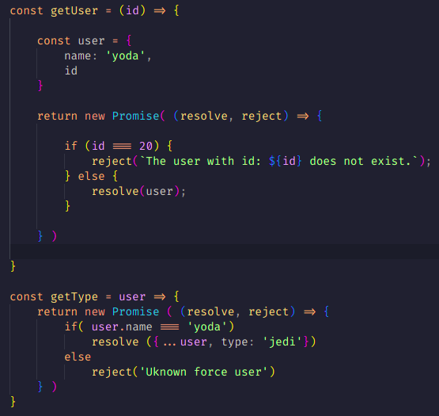
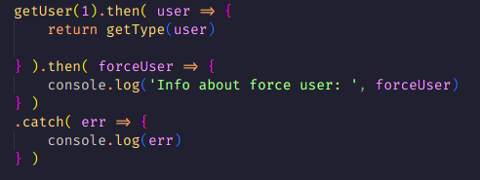
JavaScript - Promises : Chained promises

Slide 18
JavaScript - Async / Await
Async transforms a function into a Promise
Await makes the promises execute sequentially
Await can only be used inside an async function

Slide 19
JavaScript - Async / Await
const getUser = async id => {
const user = {
name: 'yoda',
id
}
if (id === 20) {
throw(`The user with id: ${id} does not exist.`);
} else {
return(user);
}
}
const getType = async id => {
const user = await getUser(id) // se para aquí hasta que no tenga la respuesta
if( user.name === 'yoda')
return ({...user, type: 'jedi'})
else
throw('Unknown force user')
}

Slide 20
JavaScript - Async / Await
getType(1).then( user => {
console.log('Info about force user: ', user)
}).catch( err => {
console.log(err)
});

Slide 21
JavaScript - DOM
Stands for Document Object Model
Platform and language neutral interface that allows programs and scripts to dynamically access and update the content, structure and style of a document.
JavaScript can, for example:
Add, remove and change all the HTML elements/attributes
React to existing HTML events and create new
Change CSS styles

Slide 22
JavaScript - DOM
Document
Root element <html>
Element:
<head>
Element:
<body>
Element:
<meta>
Element:
<title>
Element:
<a>
Element:
<p>
Text:
“Space bags”
Text:
“Galactica”
Attribute:
“href”
Text:
“Home”
Text:
“Welcome”

Slide 23
JavaScript - Finding methods
To get elements by its attributes
getElementById - first element with specified id
getElementsByClassName - array of elements by class
getElementsByName - array of elements by name
getElementsByTagName returns an array of elements by tag
Other types of methods
Adding elements: createElement, appendChild...
Deleting elements: removeChild, replaceChild...

Slide 24
JavaScript - Files
Like CSS, it can be imported from a .js file
It can be added in the <script> tag
<script type="text/javascript" src="main.js"></script>
<script type="text/javascript">
window.onload = function () {
alert('the game')
}
</script>

Slide 25
JavaScript - Files
And it can be coded inside a tag, calling an event like “onclick”
However, this form is not recommended for multiple event listeners
<button onclick="alert('am i a joke to you?');">Do NOT click me!!</button>

Slide 26
JavaScript - Where
In the <head> so it is ordered and follows logic structure
Sometimes found inside <body> because of loading times
Loading related events
Before loading: the site is not loaded
ready: the structure is fully loaded
onload: everything is loaded including iframes, photos...

Slide 27
JavaScript - Starting
Different ways to display stuff
<html>
<head>
<script>
document.getElementById("main").innerHTML = 12 / 1;
</script>
<head>
<body>
<div id=”main”></div>
</body>
</html>
document.write(2 + 10);
alert(6 + 6);
console.log(4 * 3);

Slide 28
JavaScript - Properties
To change DOM leaves
element.innerHTML: to change the HTML
element.attribute: to change one attribute (like src, href, alt, etc.)
element.setAttribute(attribute, value): to add an attribute
element.style.property: to set a value for a css property like color, font, etc.
document.getElementById("guineaPig").innerHTML = "First";
document.getElementById("guineaPig").name = "second";
document.getElementById("guineaPig").setAttribute("alt", "Third");
document.getElementById("guineaPig").style.display = "none";

Slide 29
JavaScript - Events
onload - when the site fully loads
<!DOCTYPE html>
<html>
<head>
<script>
window.onload = function(){
alert("loaded!");
}
</script>
</head>
<body>
</body>
</html>

Slide 30
JavaScript - Events
<!DOCTYPE html>
<html>
<head>
<script>
// Enable navigation prompt
window.onbeforeunload = function() {
return true;
};
// Remove navigation prompt
window.onbeforeunload = null;
</script>
</head>
<body>
<a href=”https://www.google.com”>
</body>
</html>
onbeforeunload - to display a message before leaving the site

Slide 31
JavaScript - Events
<!DOCTYPE html>
<html>
<head>
<script>
window.onload = function(){
document.getElementById("fname").onchange = myFunction;
}
function myFunction() {
var x = document.getElementById("fname");
x.value = x.value.toUpperCase(); }
</script>
</head>
<body>
Enter your name: <input type="text" id="fname">
<p>When you leave the input field, a function is triggered
which transforms the input text to upper case.</p>
</body>
</html>
onchange - triggered when the value changes (and lose focus)
Great on checkboxes, radiobuttons and selects
Alt: oninput

Slide 32
JavaScript - Events
onclick - triggered when the element is clicked (mouse down and up)
<!DOCTYPE html>
<html>
<head>
<script>
window.onload = function(){
var h1 = document.getElementById("h1text");
h1.onclick = function(){ changeText(h1) };
}
function changeText(id) {
id.innerHTML = "Ooops!";
}
</script>
</head>
<body>
<h1 id="h1text" >Click on this text!</h1>
</body>
</html>

Slide 33
JavaScript - Events
onmouseover - the mouse is moved over an HTML element
onmouseout - the mouse is moved away an HTML element
onkeydown - a keyboard key is pushed
onkeypress - a key is pressed down and up
onfocus - an element gets focus
onpagehide - similar to onunload

Slide 34
JavaScript - Animations
setInterval - to make a function repeat in time
setTimeout - to wait before executing a function
setInterval( function(){ alert("done") }, 3000);
setTimeout(showThings, 5000);
function showThings() {...}

Slide 35
JavaScript - Other
addEventListener() - to create events
focus() - to make an element gain focus
HTML Attribute tabindex - to set an order for input focus
+ to concatenate strings (“string1” + “string2”)
Differents files for different functions
document.getElementById("ex1").addEventListener("click", function(){ alert("done") });

